Slide 1


NFL Game Prediction
Joshua Busser, Aaron Steenerson,
Tesfanesh Sebsibe & Mackenzie Swaney

Slide 2
Project Outline
Data Used: 2009 - 2019 NFL data
22k-ish rows x 256 columns
Project: Use NFL regular season stats to build a machine that predicts outcome
34 different variables (for each Home & Away teams), over 10 seasons are used to make predictions
Programs Used: Python Pandas, SKlearn Random Forest, Numpy

Slide 3
Data Cleaning - Python Pandas
Kept:
Game ID (Primary Key)
Home & Away team names
Anything that can be averaged for machine use (i.e., #s, stats)
Also needed to break up some stats between Home & Away teams that wasn’t previously laid out in individual columns
Group by Game ID, so data is in one line per game ID to analyze & predict with

Slide 4
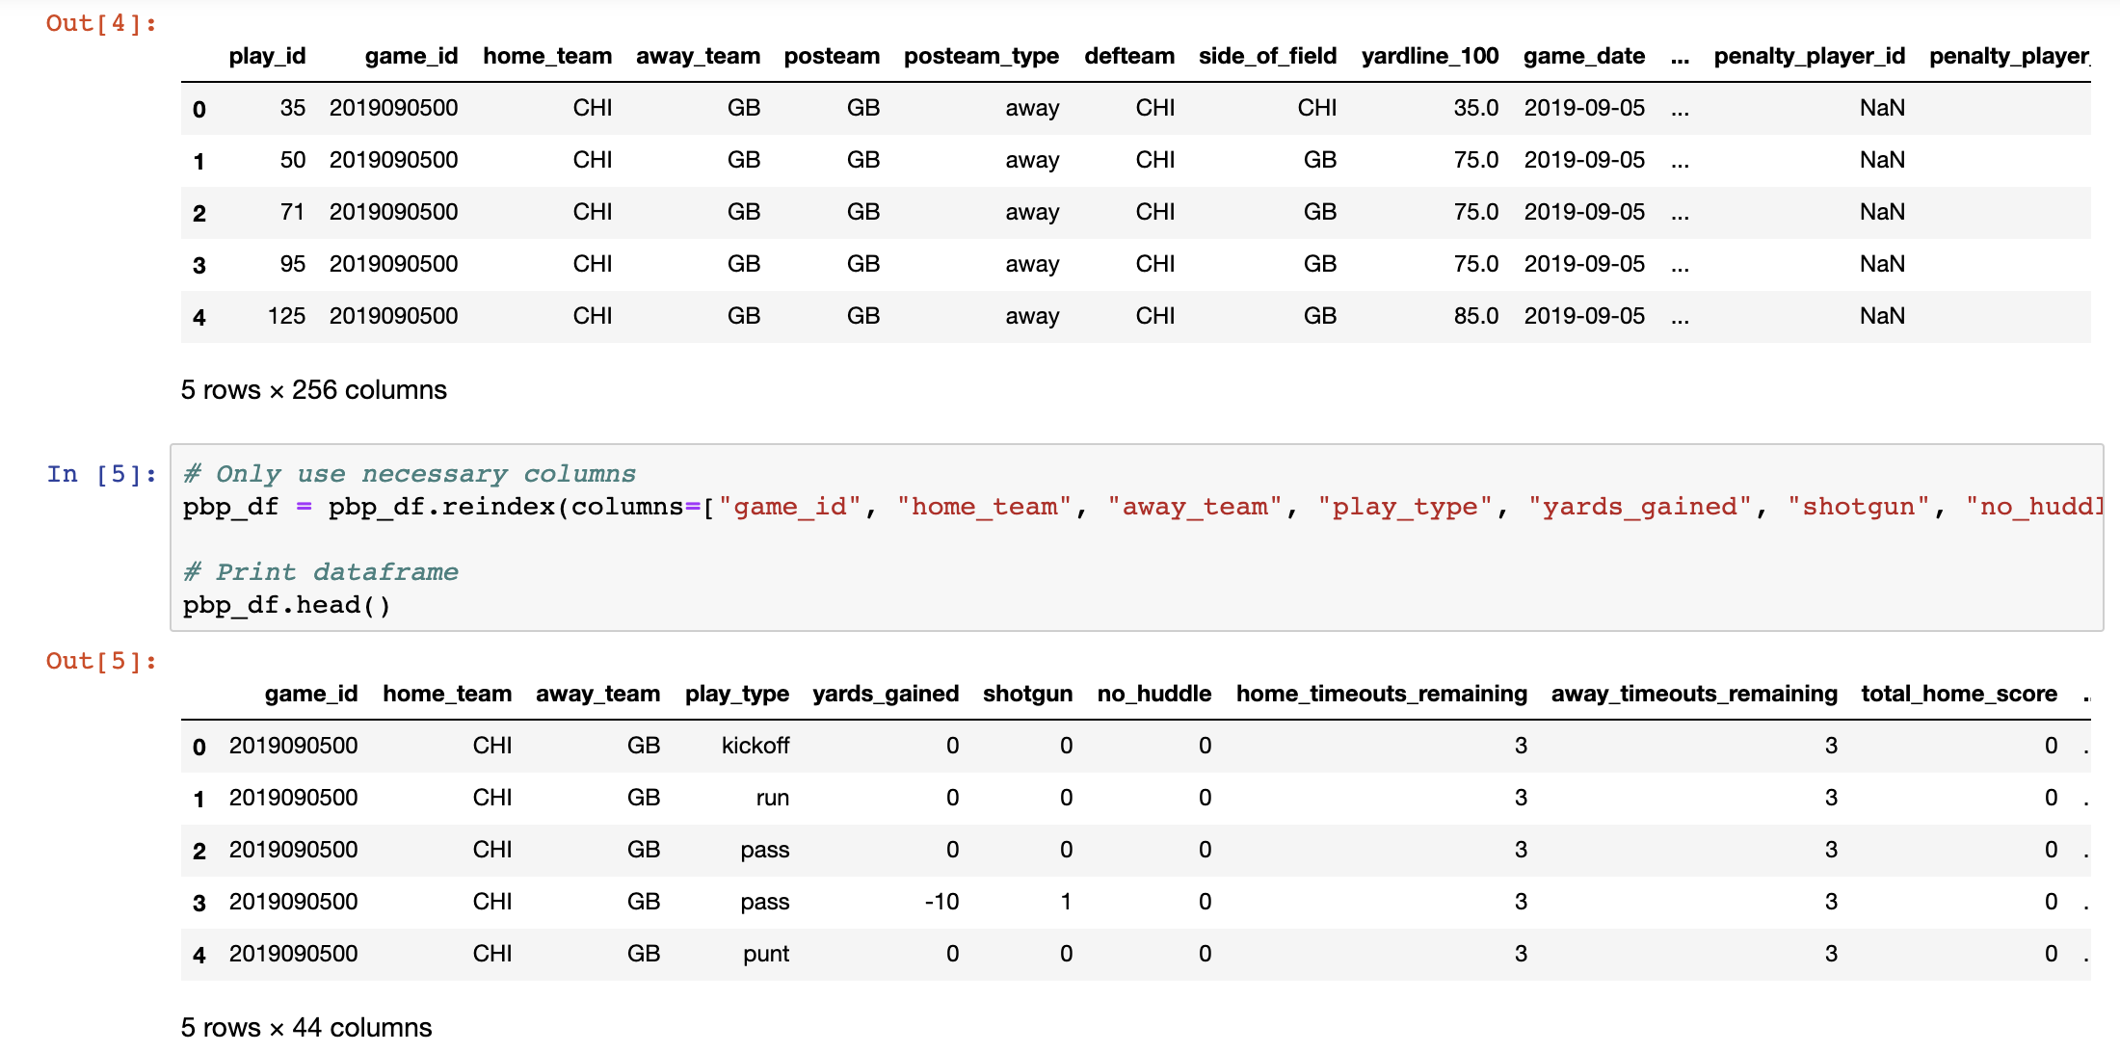
Cleaning Play-by-Play Data

Slide 5
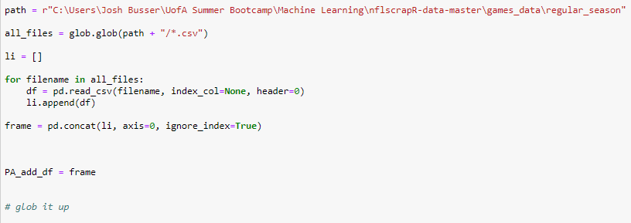
Import Data from Every Season

Slide 6
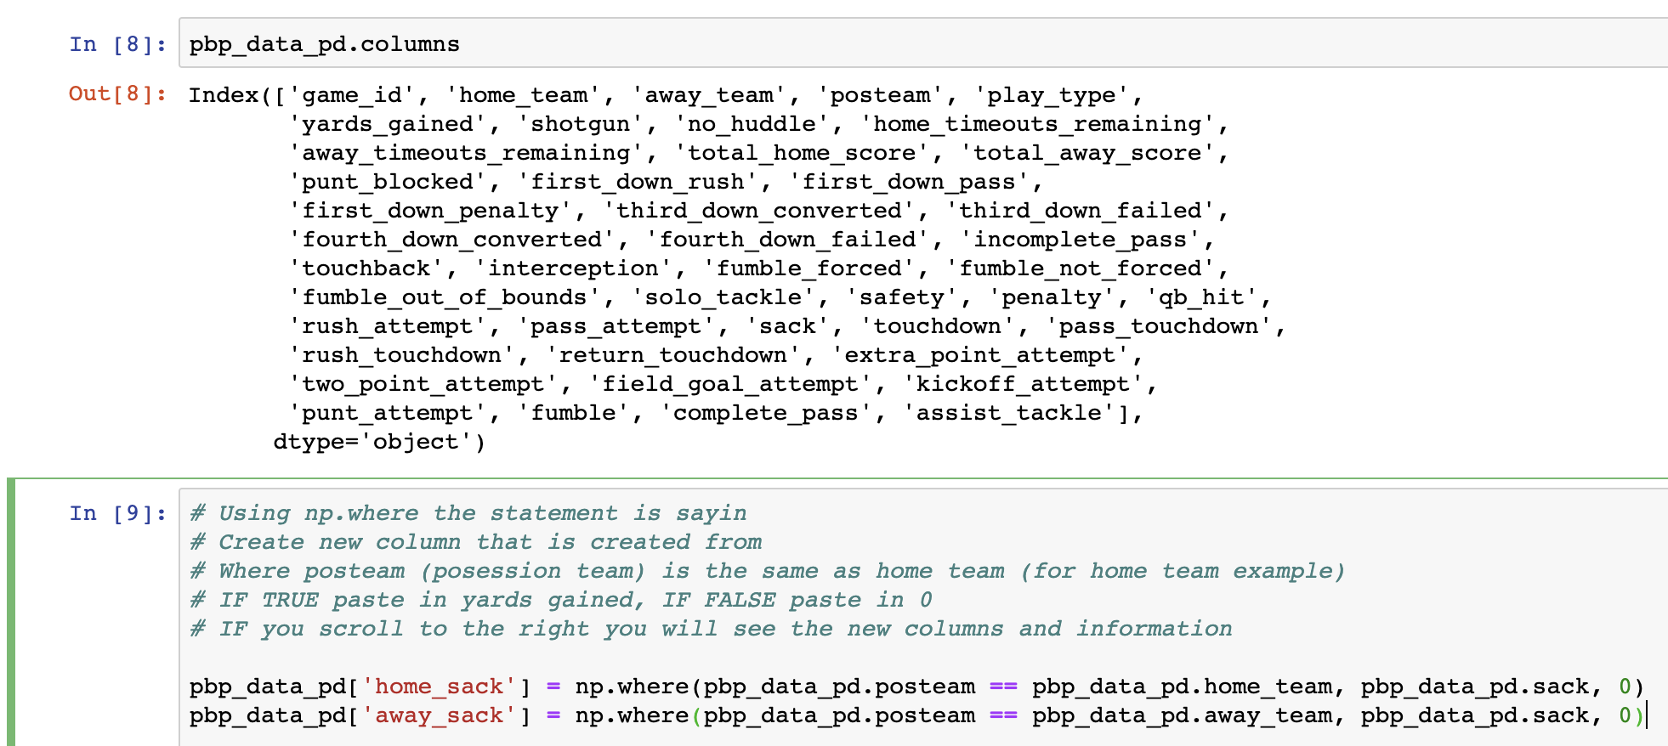
Cleaning Play-by-Play Data (continued)

Slide 7
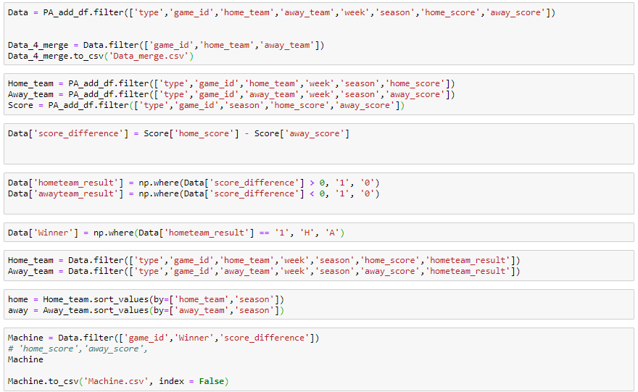
Determine the Winner for Each GameID

Slide 8
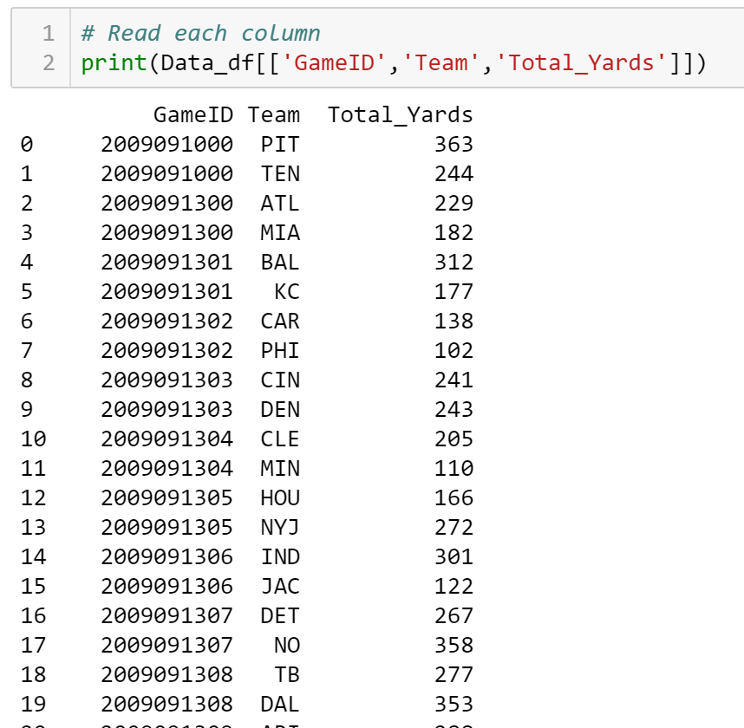
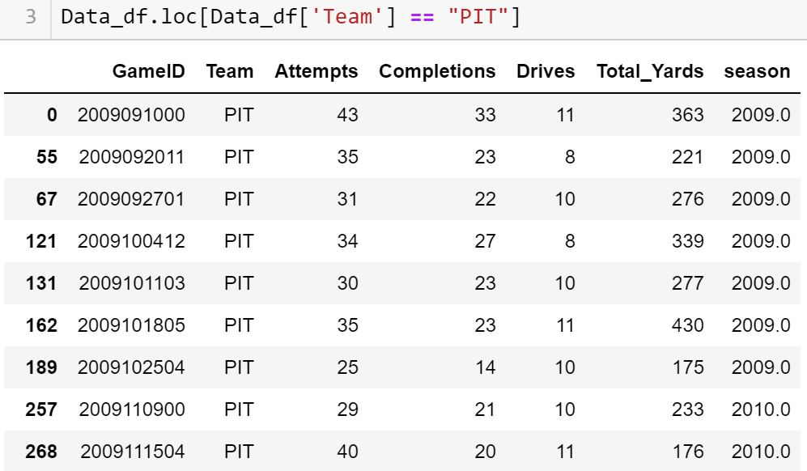
Validating our Data

Slide 9
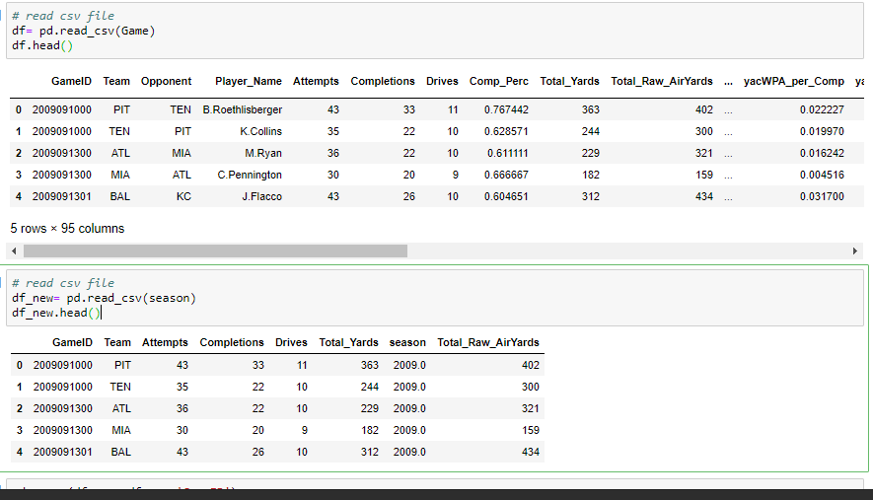
Validating continued

Slide 10
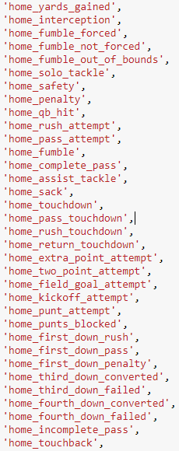
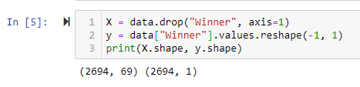
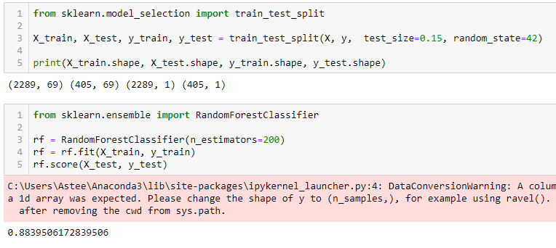
Machine Training and Testing Score

Slide 11
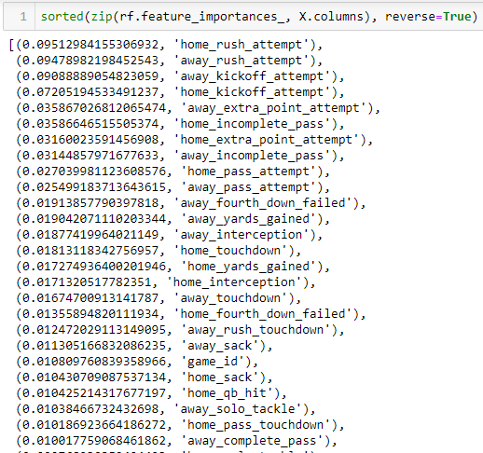
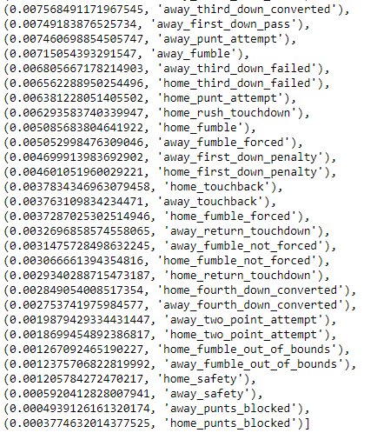
Feature Importance - Random Forest

Slide 12
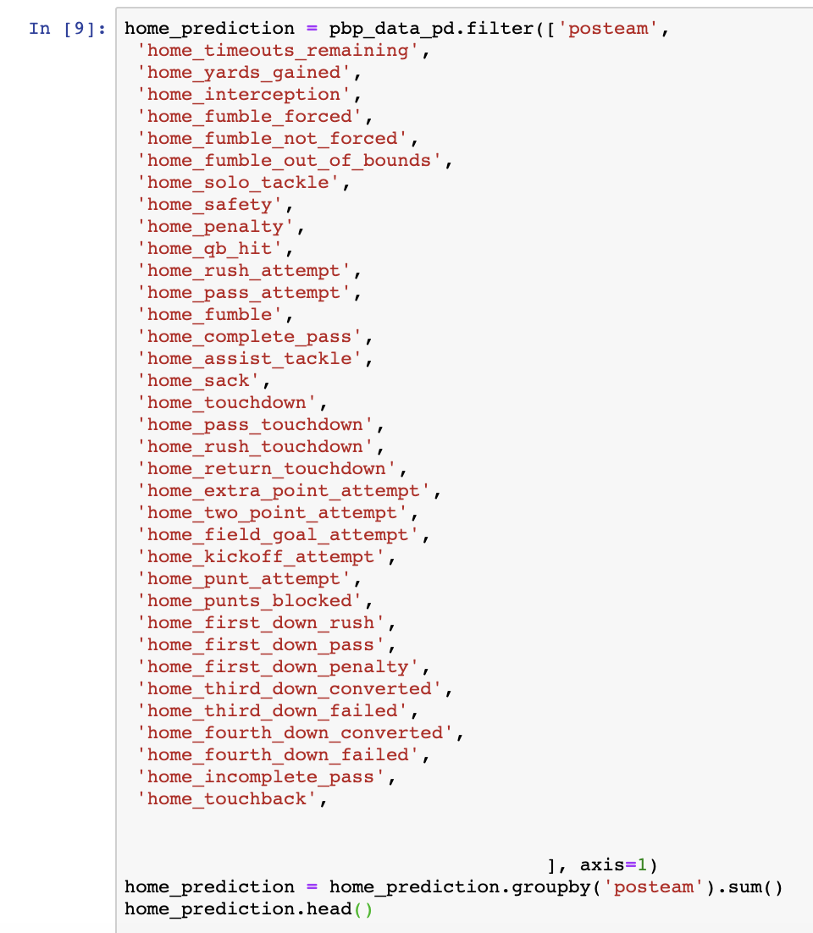
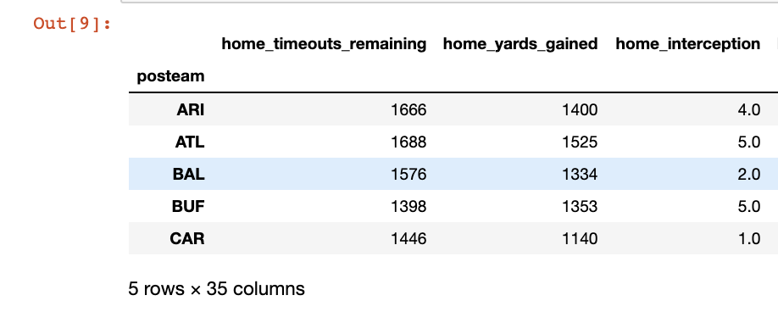
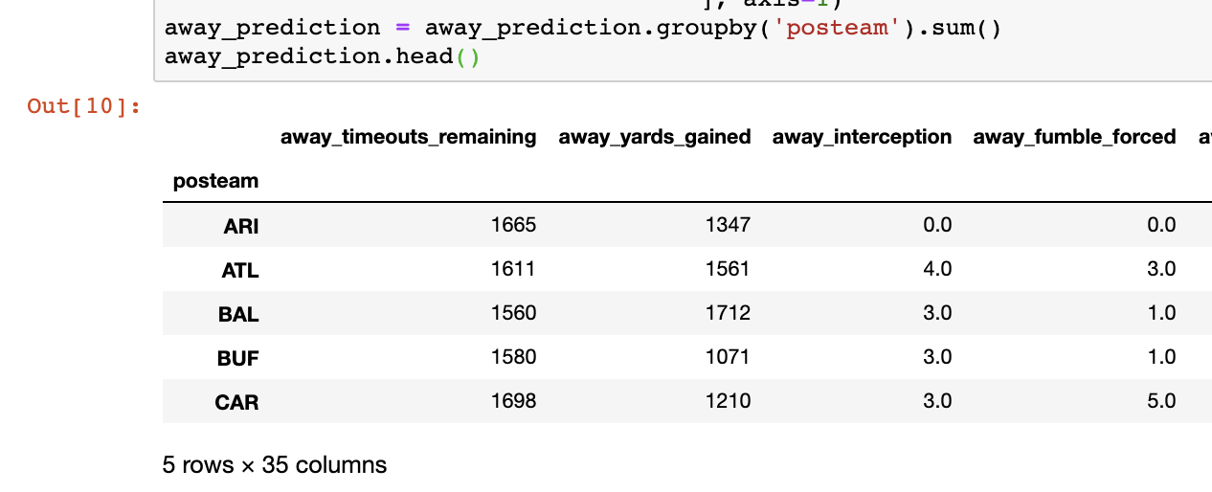
Prediction Data - Process for Home & Away Teams

Slide 13
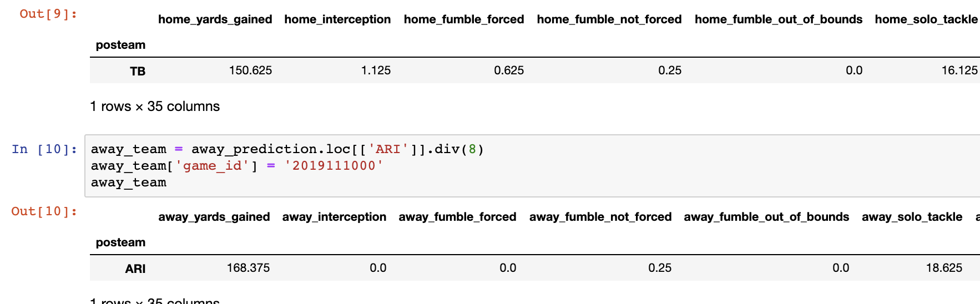
Prediction Data - Process for Home & Away Teams

Slide 14
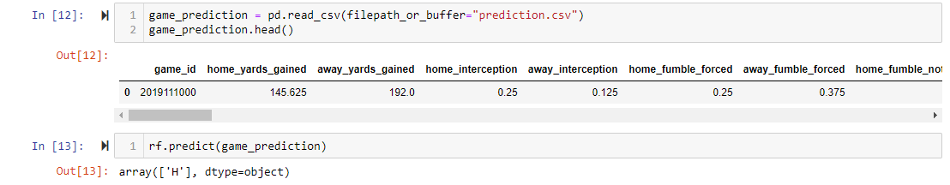
NFL Predictions through Machine Learning

Slide 15
Conflicts
Conflicts:
Headers in original CSV weren’t consistent with “home team” or “away team” (also called “posteam” and “defteam”)
Trying to combine the respective stats caused one Game ID (primary key) to be split into 2 rows of data, which caused different Game IDs between all the data
Solution: “if, then” statements for 35 columns
When building machine, we dropped “Score Difference” column, due to machine knowing to use “Score Difference” in prediction
Returned 100% accuracy, but once we dropped “Score Difference,” returned 88% accuracy

Slide 16
Key Learnings
There are only so many NFL games, which is a bit of a limiting factor
Luckily, we had 10 seasons to run through to provide more data
Primary keys are life savers!!
Our data was originally 22k+ rows, but grouping by Game ID made the data much more manageable to work with
Even if 256 original columns, look at ALL of them to understand how the data is broken down
We had to go back and figure out how to break-up Home & Away team data for certain stats in order to ultimately give the model equal information to make a prediction

